Slide 1
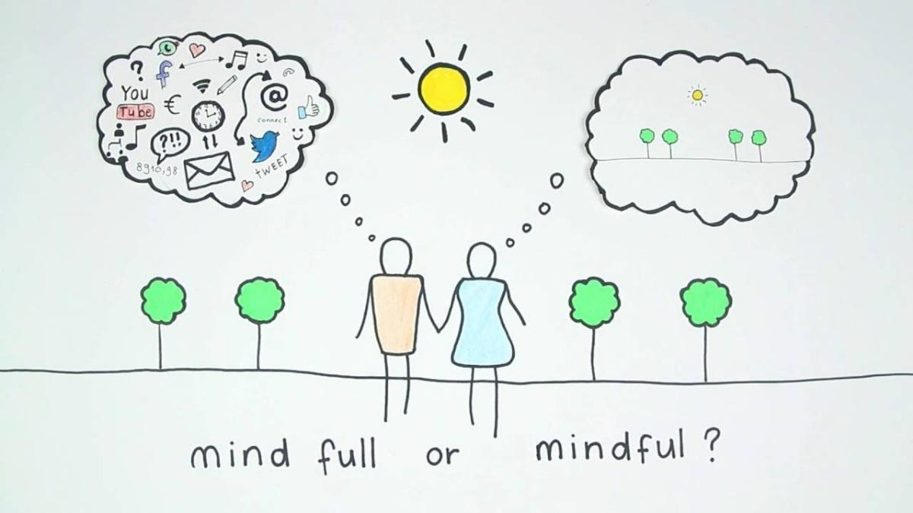
Me, Myself, & Mindfulness:
An Artistic Pause for Mental Health
Unique Robinson, MFA
Professor / Educator / Artist

Slide 2
Flow of Workshop
Materials List
Learning Outcomes
Why this Workshop? (A Few Statistics)
Before We Begin: Community Agreements
Activity #1: Mindfulness Moment
Activity #2: Poetic Release
Activity #3: Vows & Vision Board
  Activity #3.1: Making Vows
  Activity #3.2: Visualizing the Vision
Shareout
Close

Slide 3
Materials
“Me, Myself, & Mindfulness” PowerPoint
Pen or Pencil
“Dear _____” letter poem handout
Blank sheet of paper (or journal)
Colorful markers
At least 6 magazines (for use during Visions & Vows board creation)
Card stock (#: as many students as you have)
Glue sticks (#: as many students as you have)
Notebook for taking your own notes during discussions in PowerPoint

Slide 4
Learning Outcomes
Students will learn how to employ creative outlets for their mental health and well being.
Students will learn new tools to regulate their own emotions, and develop a deeper awareness of their own emotional state through mindfulness exercises.
Students will create a safe space to be able to discuss their own and their peers’ mental health.
Students will be able to write a poem discussing their own mental health, in a supportive environment.
Students will create Visions & Vow boards, visualizing their own personal goals and aspirations.

Slide 5
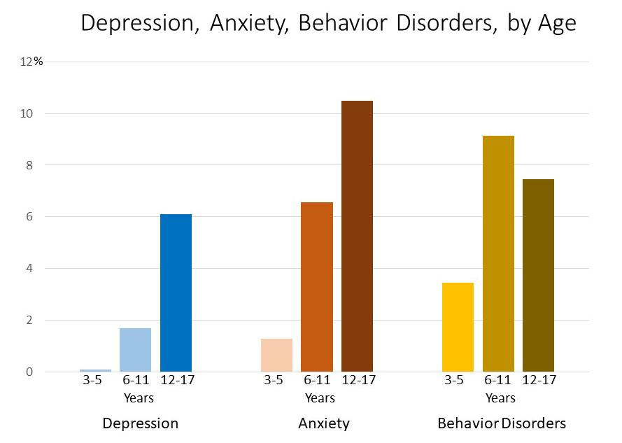
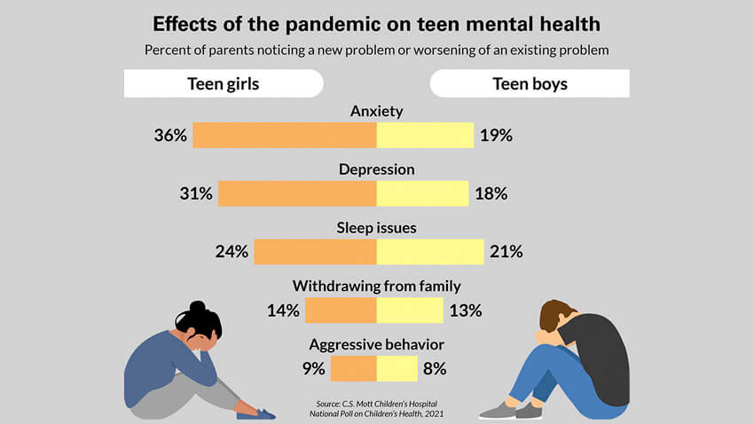
Why this Workshop?
Recent Mental Health Statistics - Youth
Mental health takes a decline during the teenage years, as we know…
…But since the pandemic, these conditions have exacerbated.
Notes:
1st Slide Source: CDC, “Data and Statistics on Children’s Mental Health”.: https://www.cdc.gov/childrensmentalhealth/data.html
2nd Slide Source: National Poll on Children’s Health, 2021: https://mottpoll.org/reports/how-pandemic-has-impacted-teen-mental-health

Slide 6
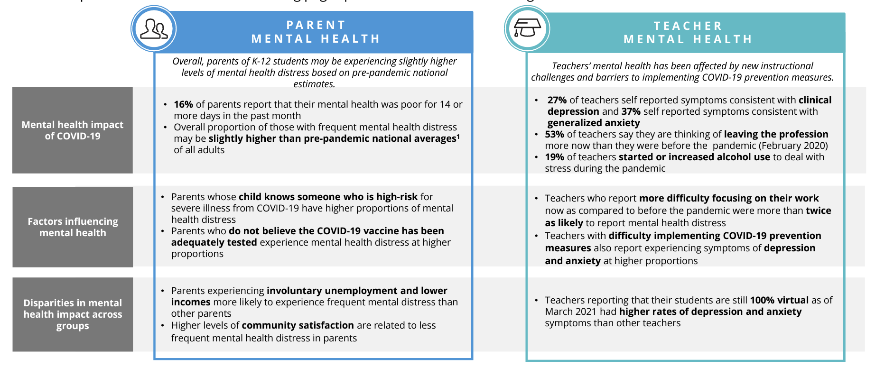
Why this Workshop?
Recent Mental Health Statistics - Adults
Parent and Teacher mental health have suffered as well. All of these factors impact school and classroom climate, overall, and must be viewed collectively.
Notes:
Source: CDC Foundation, Mental Health Impact of the COVID-19 Pandemic on Teachers and Parents of K-12 Students, May 2021.

Slide 7
Before We Begin: Community Agreements
It is always helpful to draft or reference your Community Agreements (aka, Group Agreements or Classroom Guidelines) before launching into this exercise. Some helpful ones include…
What happens here, stays here
Speak using “I” statements
Ask, don’t assume
Active listening: Be patient and allow others to share before you speak
Be non-judgmental with what others share
Practice empathy: Try to put yourself in someone else’s shoes
Intent vs. Impact: Being mindful of tone, body language, and approach when speaking to others, as it may impact them in a way you are not always aware of.
Disclaimer: This workshop is not intended to replace therapy or counseling for youth; it is simply meant as an additional resource and creative outlet in the classroom for what they may be experiencing.

Slide 8
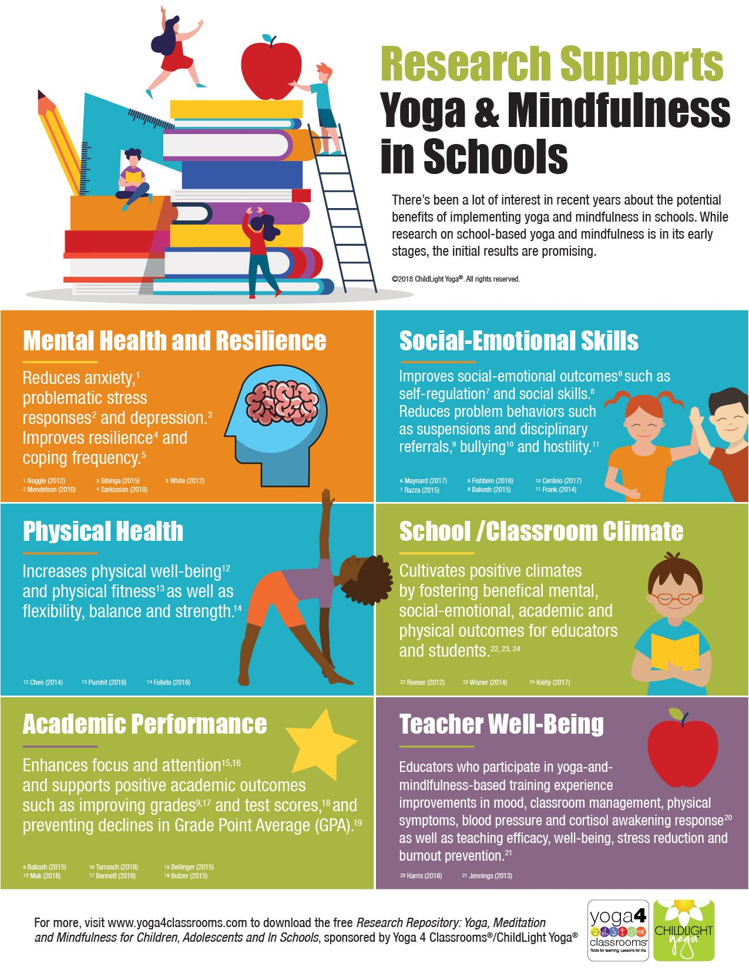
Activity #1: Mindfulness Moment
(5 minutes)
For Beginner students and teachers (ie, this is your first time using mindfulness exercises)...you may start by asking students,
WHAT IS MINDFULNESS? Ask a few to share their thoughts.
Then proceed with the 4-4-4-4 method, instructing your students to follow along and model:
4 seconds to inhale
4 seconds to hold their breath (if they are able to)
4 seconds to exhale
Repeat 3 more times (aka, 4)!
For Intermediate students and teachers (ie, those who have already implemented a mindfulness practice in your classroom):
Please utilize the above, or try out some of your own that have worked well.
(A few reasons for why mindfulness can be helpful! You can feel free to share some of these with your students! )

Slide 9
Activity #2: Poetic Release (15 minutes)
Writing continues to be one of the most cathartic and accessible forms of releasing emotions, as well as to process difficult experiences. Please utilize this open-ended prompt, to allow students to share what they may be feeling in the moment.
Understand that some students may have various levels of trust issues with the classroom, with authority, and with being vulnerable. So, allow students to share as much or as little as they wish. The goal is not to send students into a space they are not able to come back from.
Dear _______,
What I want to tell you is… (have students fill in blank space from here. If students are having a hard time writing on their own, you can utilize the following prompts, and instruct students to list them, in this order:
Lately, I’ve been feeling ___________.
I wonder if __________________.
Still, I know that ____________________.

Slide 10
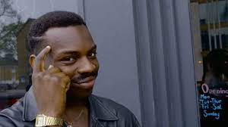
Activity #3: Vows & Vision Board (35 minutes)
Ask students, what is the definition of a
VISION?
Take some responses.
Then, ask students what is the definition of a
VOW?
Take a few responses here.
From here, instruct students that they will work on creating a vision board, incorporating vows that they have written to themselves. (please see next slide for more information)

Slide 11
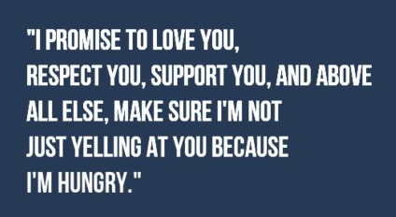
Activity #3.1: Making Vows (10 minutes)
On a sheet of paper, ask students to create a poem, listing at least 5 VOWS for themselves. Have them skip lines between each vow, as they will cut these out and add them to their vision boards. Ask them to be specific! Please see the example below:
Today, I vow to treat myself with love, even if I make a mistake.
I vow to keep a cool head, even when things don’t go my way.
I vow to overcome any obstacle before me.
I vow to not let my anxiety absorb me.
Even if I don’t see a change in the immediate
I know because I set these vows, eventually, I will believe in it.
Note: Sometimes, anxiety and depression can make it difficult to see beyond their current painful space. If some students have a hard time, have them write certain adjectives that describe their aspirations or desires (I want to be rich, I want to be happy, I want to be loved, I want to change the world for the better).

Slide 12
Activity #3.2: Visualizing The Vision (25 minutes)
This is where you get to bring those magazines out! Here, students are given creative freedom to cut out words, phrases, and images that speak to their future (or current) visions and aspirations for their lives.
If students want to travel, have them cut out images of airplanes or cars, or dream destinations (if high school, this vision can be right around the corner, with Learner’s Permits)!
If students want to be singers or actors, have them cut out images of their favorite musicians or actors.
If students want to create change in the world in some way, have them cut out an image of some issue they’d hope to change.
Remind students that they can’t bring their aspirations into reality without first visualizing them, believing they deserve this vision, and making space for it to arise!
Once students have gathered enough images, have them arrange them on the cardstock, using glue.
Students will also glue their vows to themselves, in various spaces throughout their vision board (of their choosing).
Please see my example Vision Board, on the next slide.
Note: Encourage more visually-inclined students to draw out their visions as well!

Slide 13
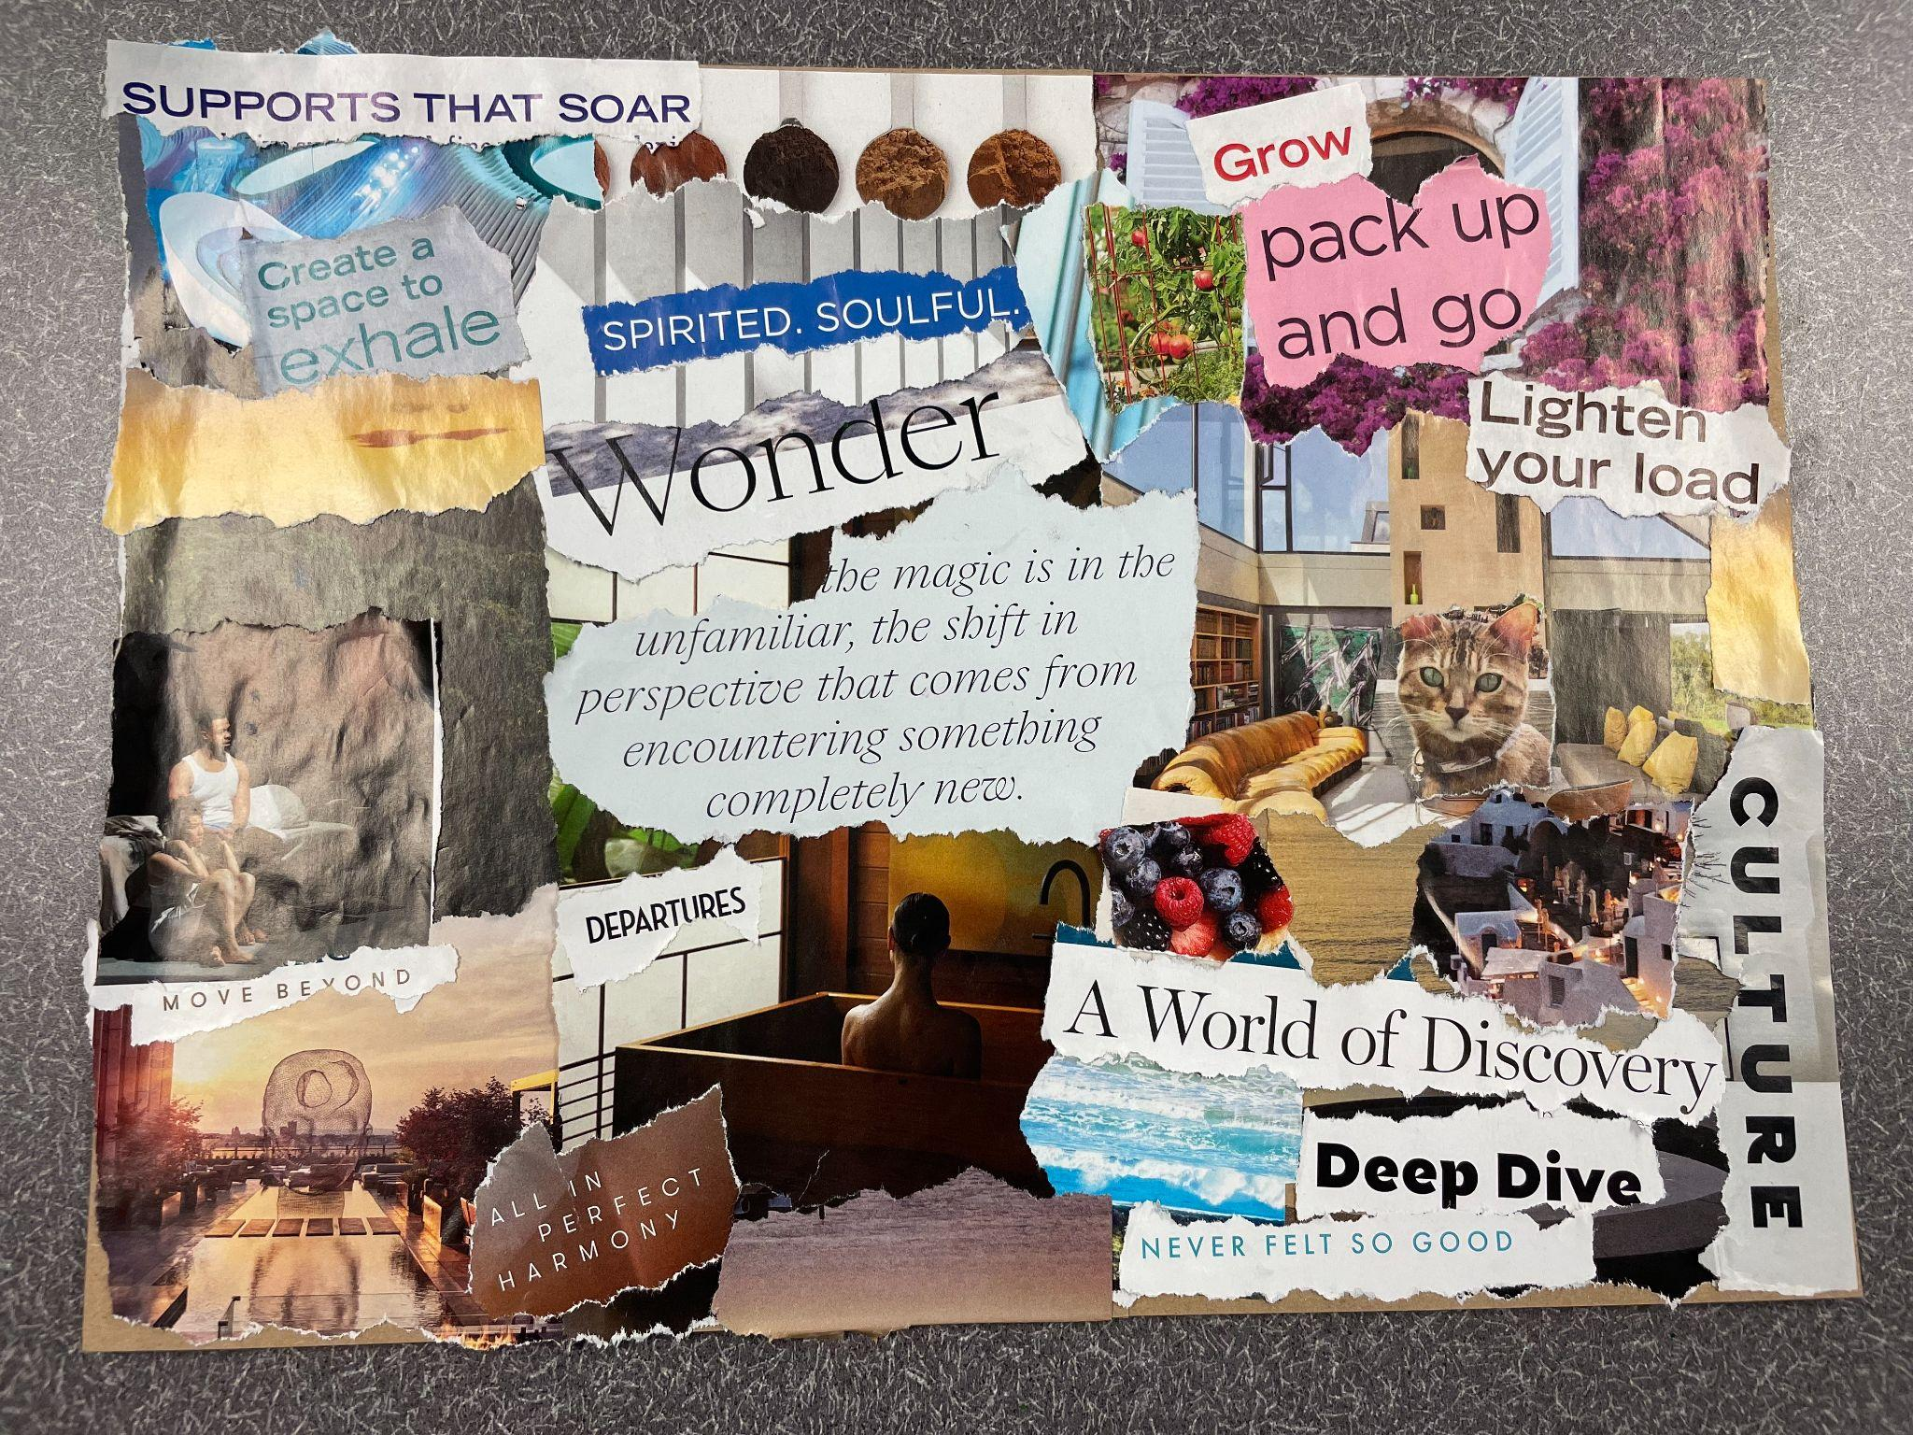
Activity #3: Vows & Vision Board
Some of my vows have been incorporated, using the magazines:
I vow to be in harmony with myself.
I vow to create a space to exhale.
I vow to travel more (“pack up and go”).
I vow to be open to new experiences and discoveries.
I vow to bring my creative visions into reality (hence, the theater show, on the left).

Slide 14
Share out! (5 minutes)
Have select students share their vision boards aloud.
Remind students that they can take these home with them, to continue visualizing beyond their current circumstances.

Slide 15
Local Mental Health Resources
To get connected to a therapist (with insurance or Medicaid):
Pro Bono Counseling Project:
https://probonocounseling.org/ 410-885-1001
For additional support, workshops, etc:
National Alliance on Mental Illness (NAMI) Metro Baltimore:
http://namimd.org/
410-435-2600

Slide 16
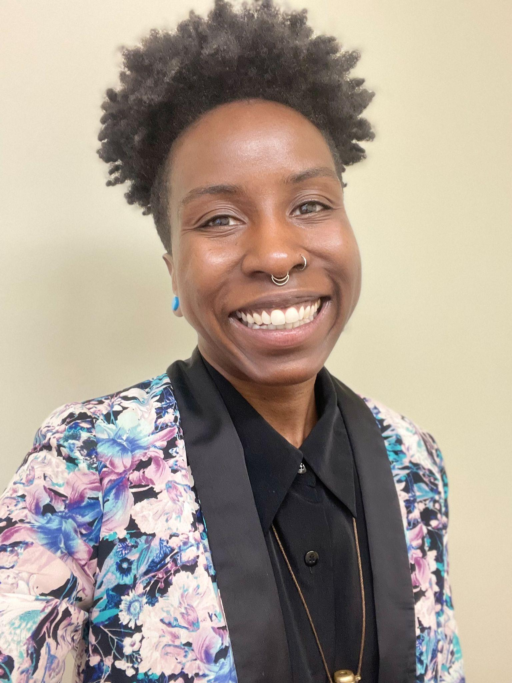
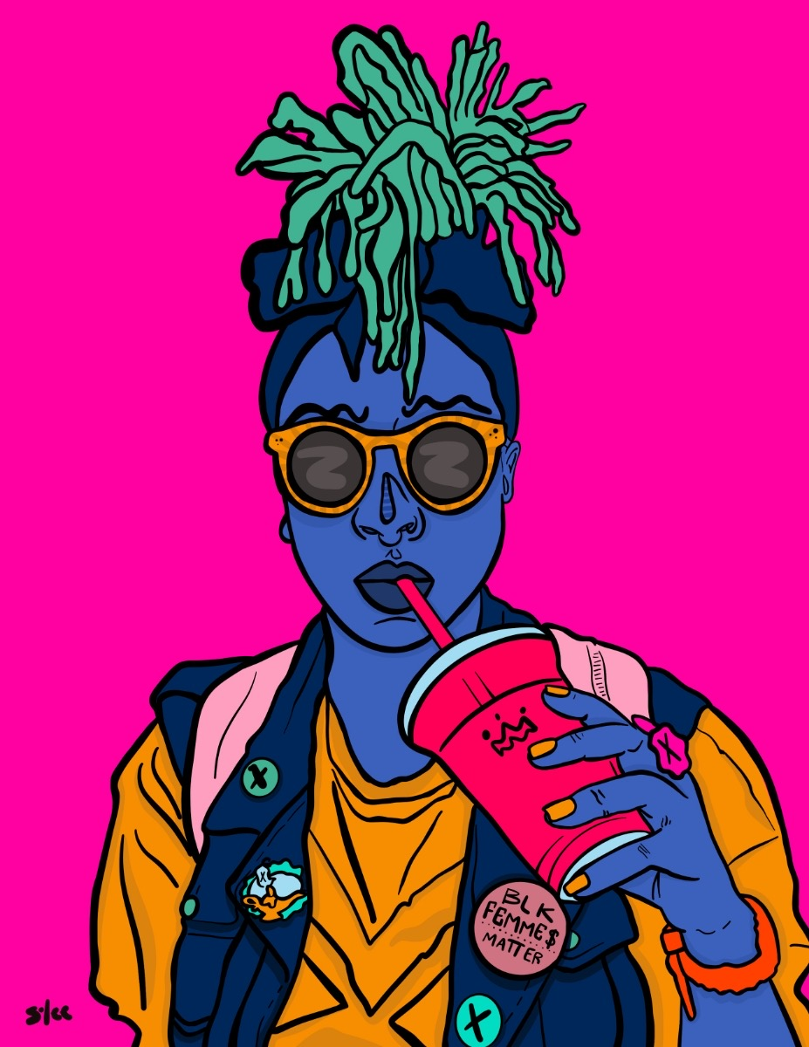
About The Presenter
Unique Mical Robinson is a poet, performer, professor, educator, host, & proud Baltimore native. She began performing at 14 on Baltimore's open mic & slam circuit, and has had the fortune of connecting and performing with various communities throughout the US, and Havana, Cuba in her youth. In addition to her artistry, she has worked passionately as a Community Organizer and Youth Mentor in Baltimore, Western Massachusetts, Brooklyn, Atlanta, and Oakland.
She received her MFA in English & Poetry from Mills College in 2014, and her BA in Creative Writing & Black Studies from Hampshire College in 2009. Upon returning home, she became a Teaching Artist & Program Director/Operations Manager for DewMore Baltimore, and received the Emerging Teaching Artist award in 2017 from Arts Every Day. That same year, she co-founded blkottonkandy, an arts, music, & wellness initiative, which received the 2019 Grit Fund Grant.
She debuted her first chapbook, flicked/forgotten/FREED, in 2014, and recently released her full-length poetic memoir, Four Wings & A Prayer: A Charm City Churn, to rave reviews. Unique is currently Faculty in Humanistic Studies at Maryland Institute College of Art and Towson University, and continues to teach Poetry and Performance workshops with K-12 students in Baltimore City Schools.

Slide 17
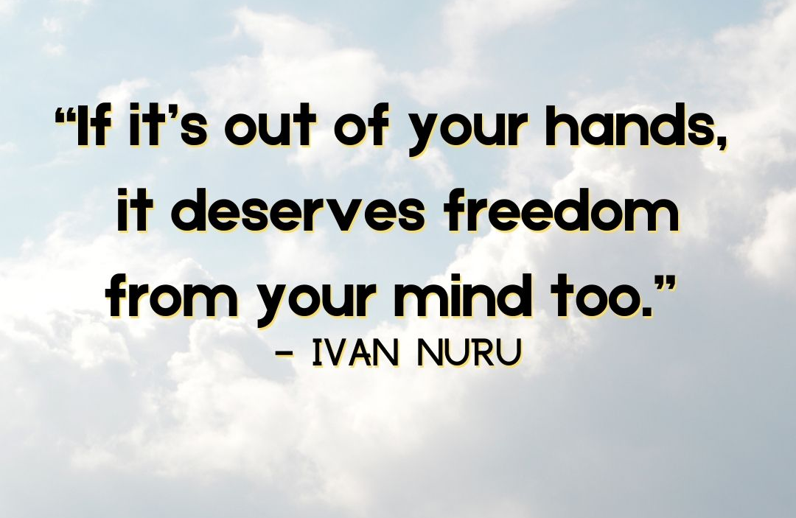
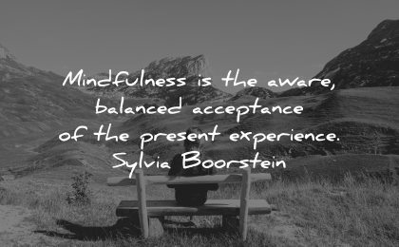
THANK YOU FOR YOUR TIME!!!!!
For questions or follow up, please email me at uni.mical27@gmail.com!

