Slide 1
Online High School Unit: Augmented Art
By Monica Heiser - April 2, 2020

Slide 2
Social & Emotional Learning:
How has the quarantine
changed your sense of place?

Slide 3
Today we will
Explore Augmented Reality Art
Go over unit schedule + assignment
Learn the AR app, Artivive
… in order to shape an artistic investigation of present day (quarantined) life using a contemporary practice of art.

Slide 4
What happens when
Pokémon GO & fine art
meet in Los Angeles?

Slide 5
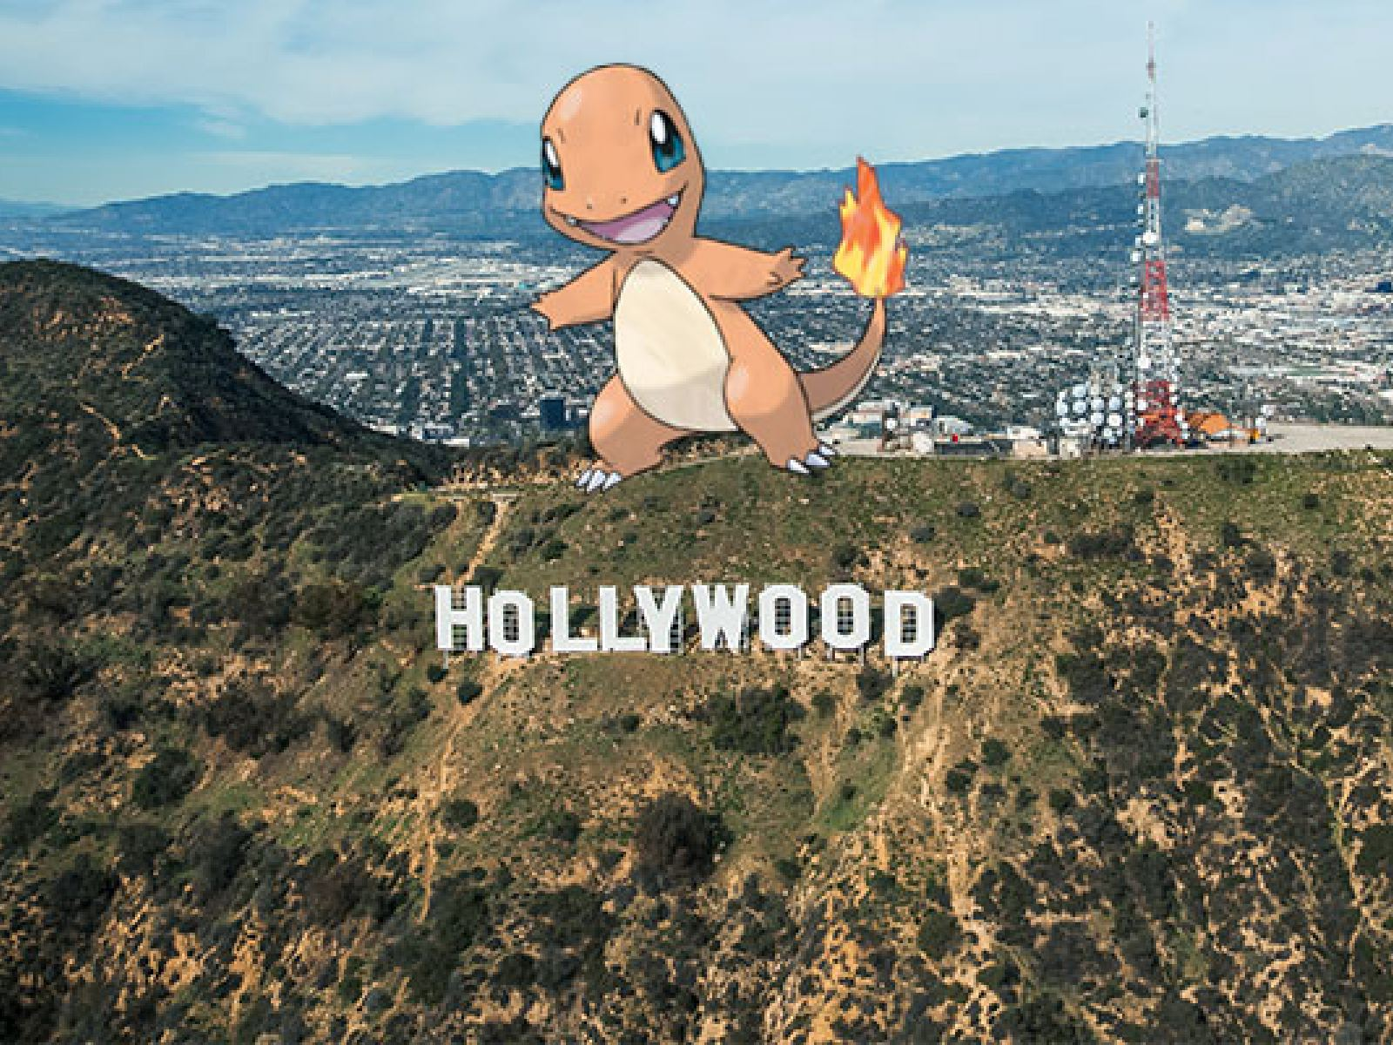
(Nooo not this :P)

Slide 6
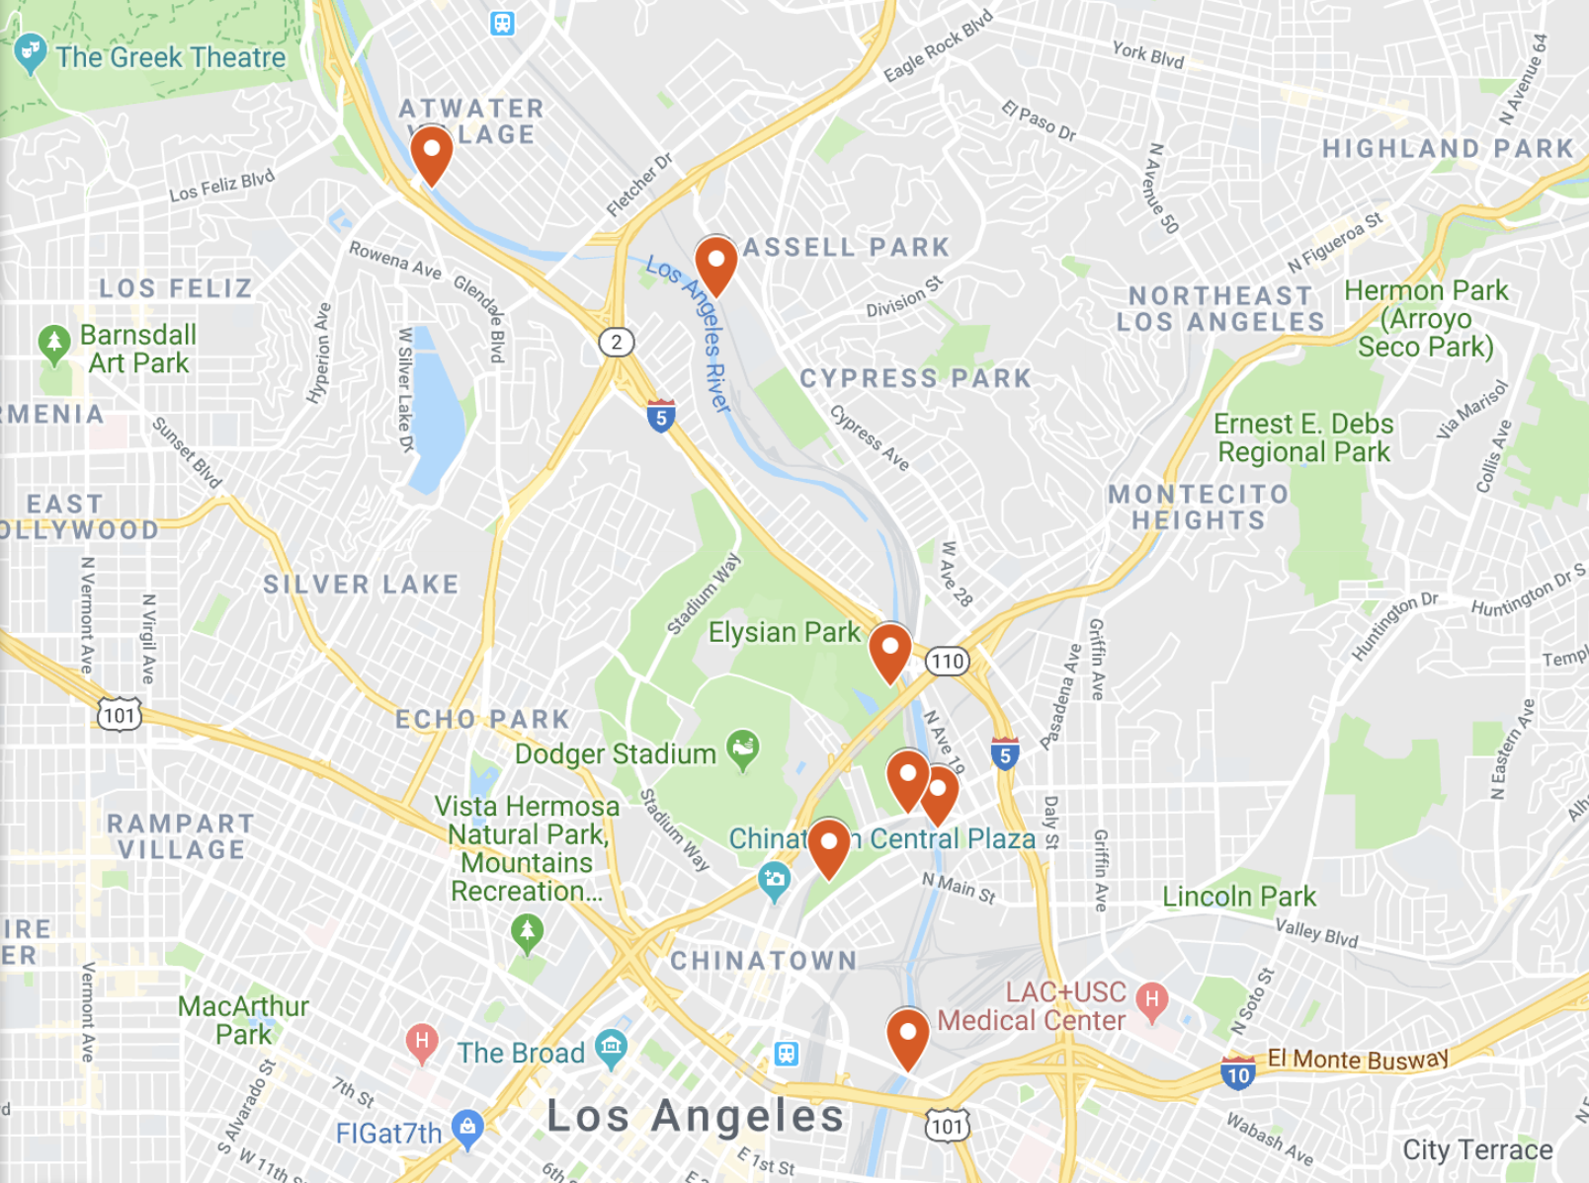
… you get Defining Line (2018).
Defining Line is a public art, augmented reality (AR) exhibition along the LA River, co-curated by Nancy Baker Cahill and Debra Scacco.
Hidden in the Elysian Park vista, the exhibit runs along a thin road that hugs the rim of the Elysian Reservoir in Los Angeles, California.
Guided by directions from the free, AR smart phone app, 4th Wall, this exhibit democratizes the experience of viewing public art.

Slide 7
Equity. Storytelling. Public AR Art
Defining Line is a public art, AR exhibition exploring how lines connect, divide and define communities.
Co-curated by Nancy Baker Cahill (Founder of 4th Wall) and Debra Scacco, the exhibit explores technology and location through powerful, site-relevant AR works along the Los Angeles River. Viewers explore the landscape while experiencing immersive storytelling outside of an art gallery.
Themes:
visibility and location; how inequity helps shape the landscape.
role of the LA river as a line that shapes the history and experience of moving through LA.
zero environmental impact or harm.
Take 5 minutes to watch this for a fantastic and short video on the Nancy Cahill and her process (click here).
​

Slide 8
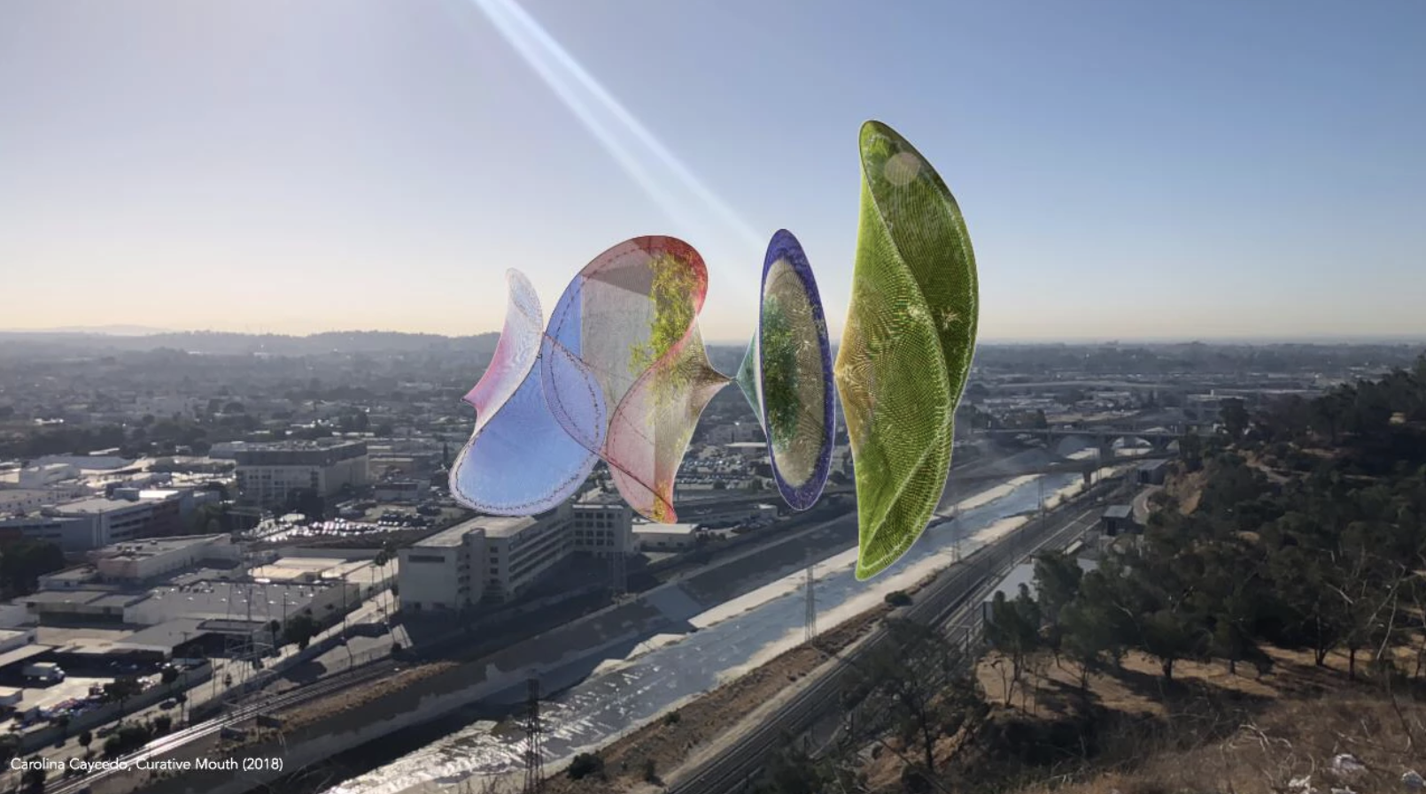
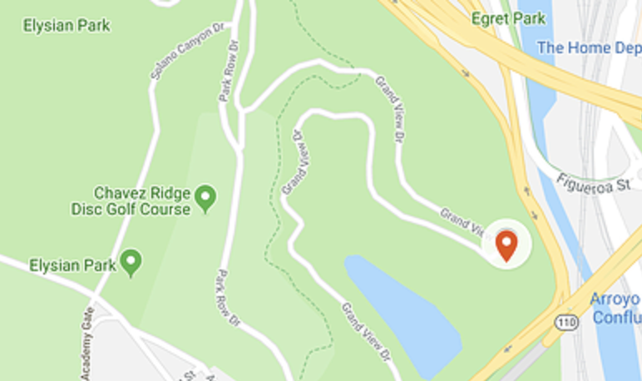
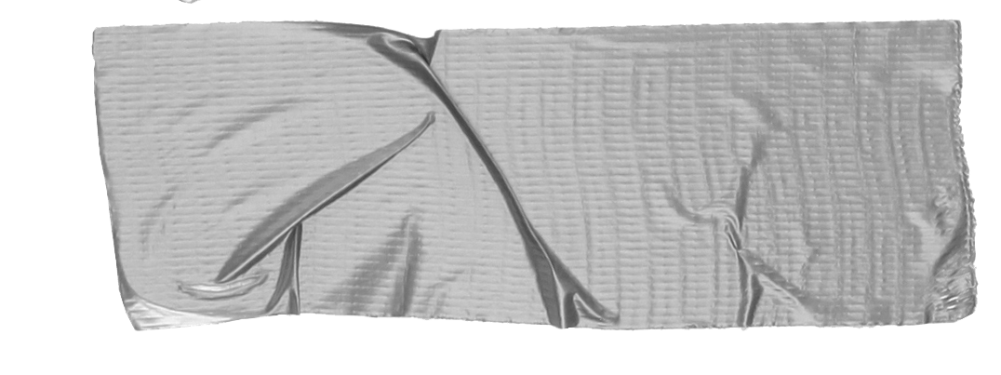

Carolina Caycedo, "Curative Mouth," (Location: 90031)
The large-scale virtual artwork features fishing nets collected during the artists’ work in global communities impacted by the privatization of water.
Tip
At Point Grand View in Elysian Park. Located at 34.08011, -118.22835
For the best vantage point, go up to the fence at Grand View Lookout in Elysian Park.

Slide 9
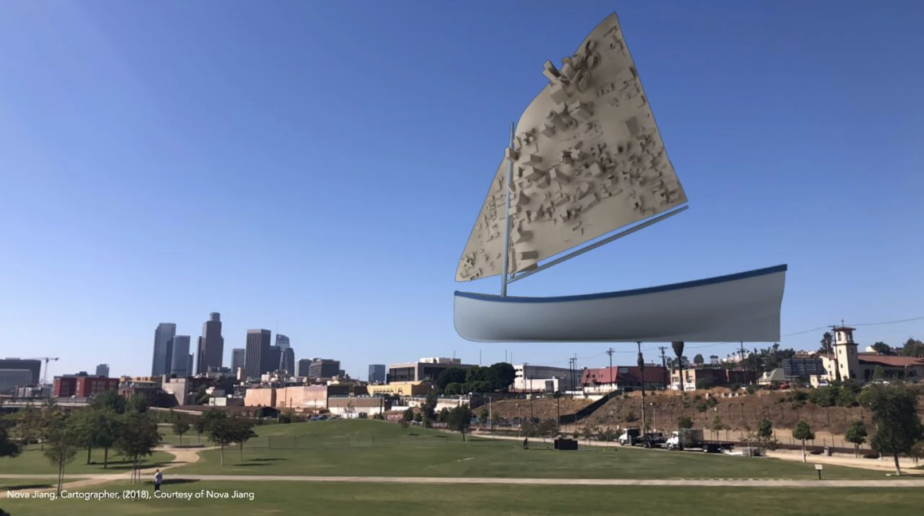
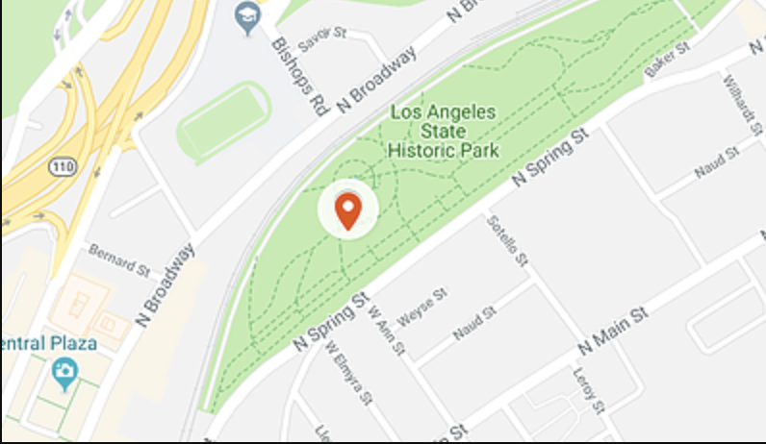
Nova Jiang’s “Cartographer”
A giant boat sails on a former floodplain towards the downtown skyline, her sail a map of the urban landscape upon which she encroaches. This work is a harbinger of rising water levels in the face of rapidly accelerating impacts of climate change. (Location: 90012)
At Los Angeles State Historic Park. Located at 34.06737, -118.23307 . For the best vantage point, go to the viewing bridge in the park and face downtown LA.

Slide 10
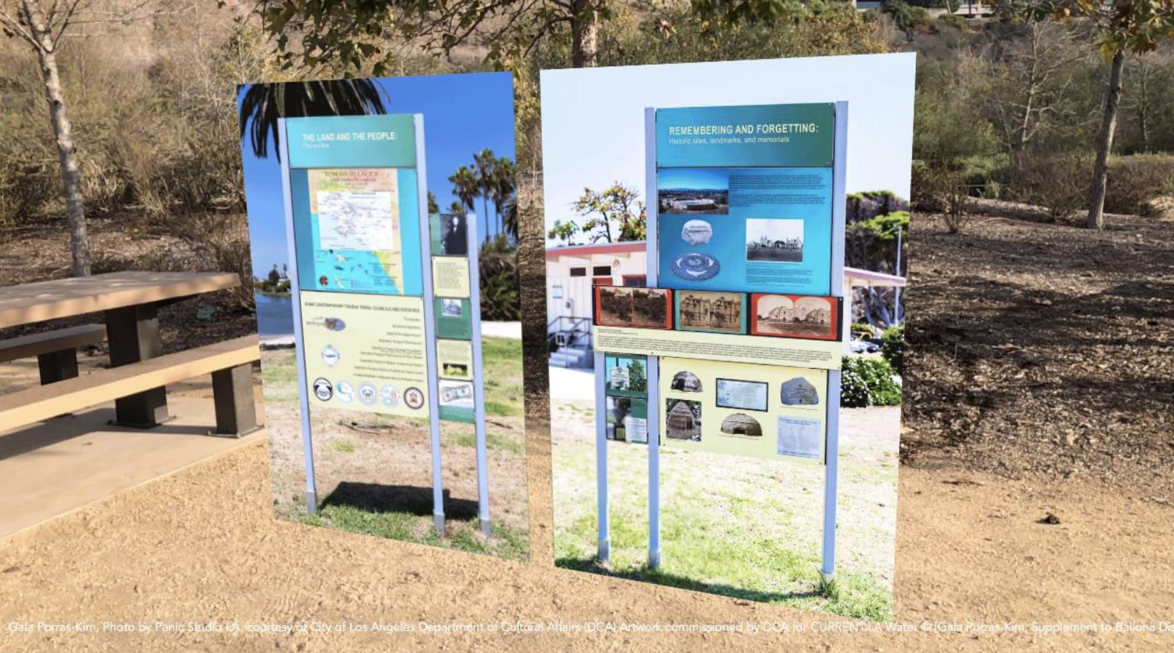
Re-imagined signs by Gala Porras-Kim tell the untold story of Gabrielino-Tongva remains, exhumed to make way for a new park at the site of the installation. (Location: 90094)
“Supplement to Ballona Discovery Park Informative Signs"
Tip
In Ballona Park, Playa Vista, CA. Located at 33.96929, -118.42373
For the best vantage point, go to 13081 Bluff Creek Drive and pass the signs on your right as you enter the park. Gala's work will appear to the left in front of you.

Slide 11
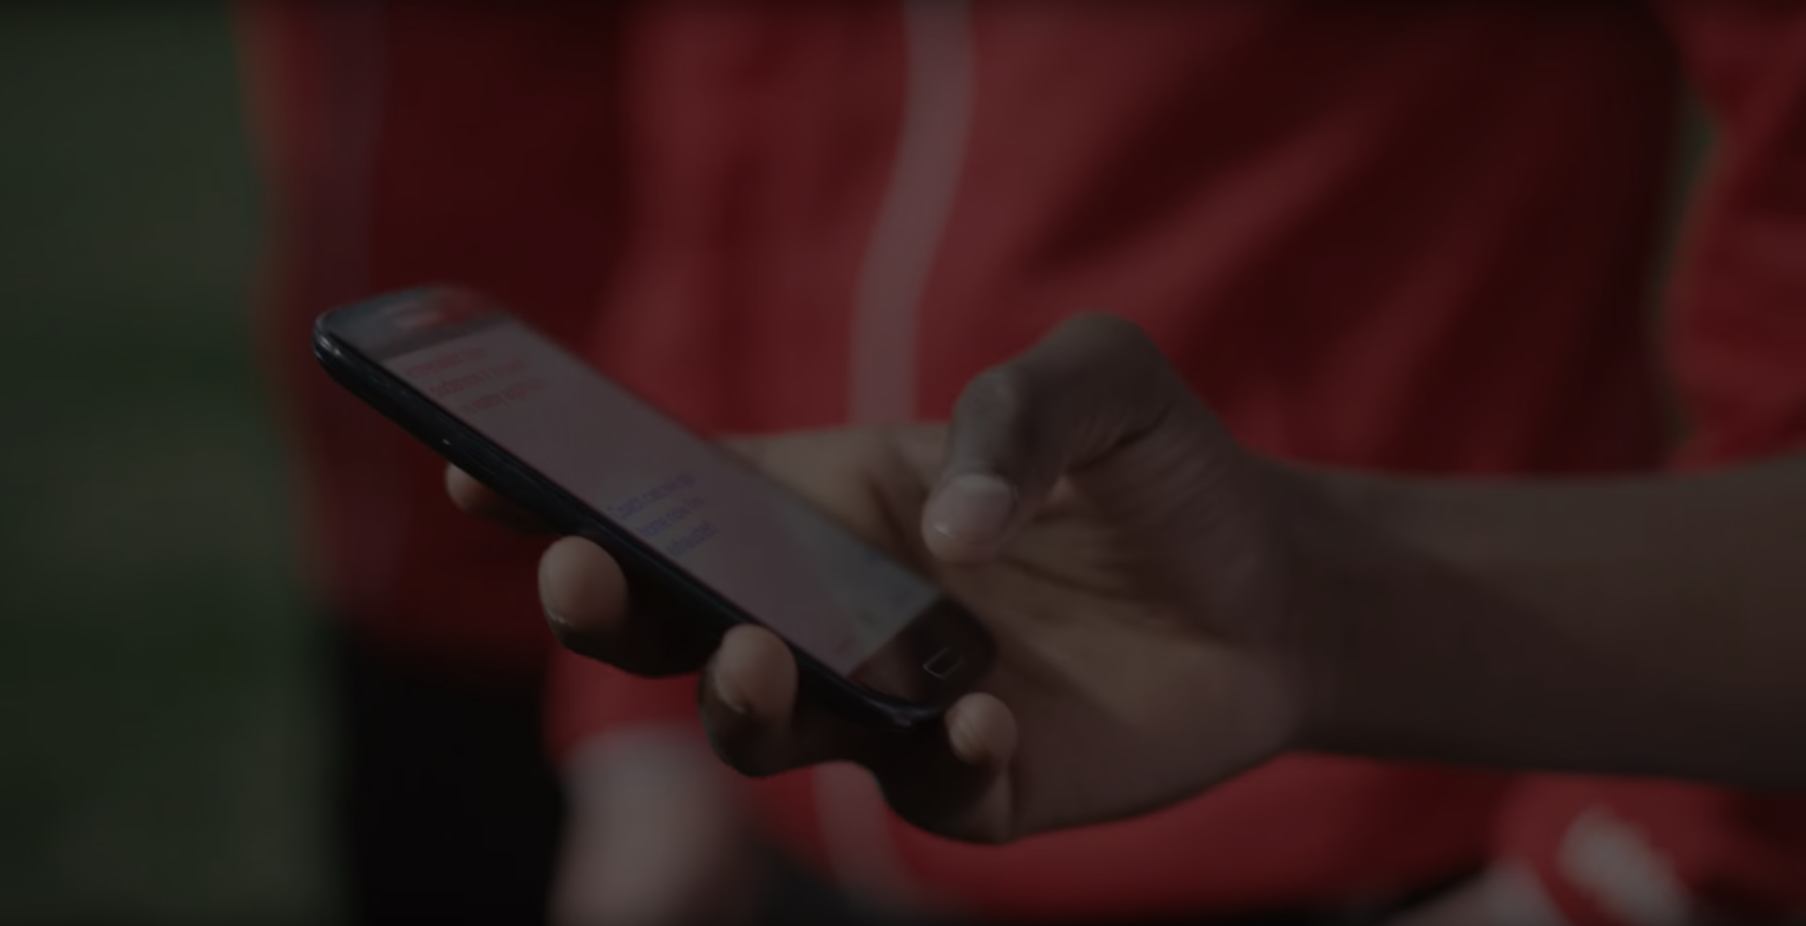
Why does AR matter for art history, and why should you care?
Notes:
Acting as an expert on new media art, explain/sell a work that we've either discussed in class (or one that you choose from your own research) to someone who isn't aware of the work, doesn't know the artist, or just doesn't "get" new media. Another approach you can take is presenting a case to an art museum/institution as to why they should preserve this particular example of new media art.
In at least 10 slides, convince this person/museum on why the work is art, why it is valuable, and why it i

Slide 12
1. Augmented Reality (AR) reveals and adds layers of reality
Locative
Uses location-based technology like GPS and wi-fi to create and comment on the sense of space and place.
Interactive
Augmented reality creates an additional layer of reality with hidden interactive animations
Accessible
Outside the confines of an art gallery, this exhibition belongs to a global audience that allows for intimate communication and interaction with the viewer, directly through their smartphone.

Slide 13
2. AR is a battleground
This virtual realm of augmented reality is a wild frontier, a blank canvas for artists.
Subversion
  “It’s a subversive project,” Cahill explains. “It doesn’t rely on permissions from institutions or on the institutions themselves. It exists outside of that.”
Changing the Narrative
  Cahill points out that as artists, we must resists VR/AR technology pressures by “... offering dynamic, thought-provoking alternatives, lest we cede that territory to commercial entities, likely unconcerned with the cultural consequences of their actions.”

Slide 14
2. AR is accessible
The intimacy and low cost of AR allows new stories to be told, centered, and heard.
Affordable Cost
  To create a physical versions of large AR works, artists would have to fundraise massive amounts of money, hire a large team, and navigate permitting, construction, and a host of bureaucratic red tape. AR projects are more cost effective, and doesn’t leave a carbon footprint.
Personal Histories
  “We’re really activating sites along the river that people wouldn’t think of as sites of cultural significance,” Cahill says, “and asking them to think about histories that have been untold.”

Slide 15
Your Assignment!
Over the course of five lessons, students will learn and experiment with Augmented Reality (AR) in order to create and publish their own AR artwork that tells a unique story about place. You will also write an artist statement to articulate your artwork’s meaning and publish it online for an online gallery walk.

Slide 16
Schedule
Lesson 1 (today): AR and Unit Intro + Tour of Artivive
Lesson 2: Analyze more AR Artists + Discuss Location in Art
Lesson 3: Art Work-time + Q&A
Lesson 4: How to Write an Artist Statement
Lesson 5: Virtual Online Gallery Walk + Self-Assessment

Slide 17
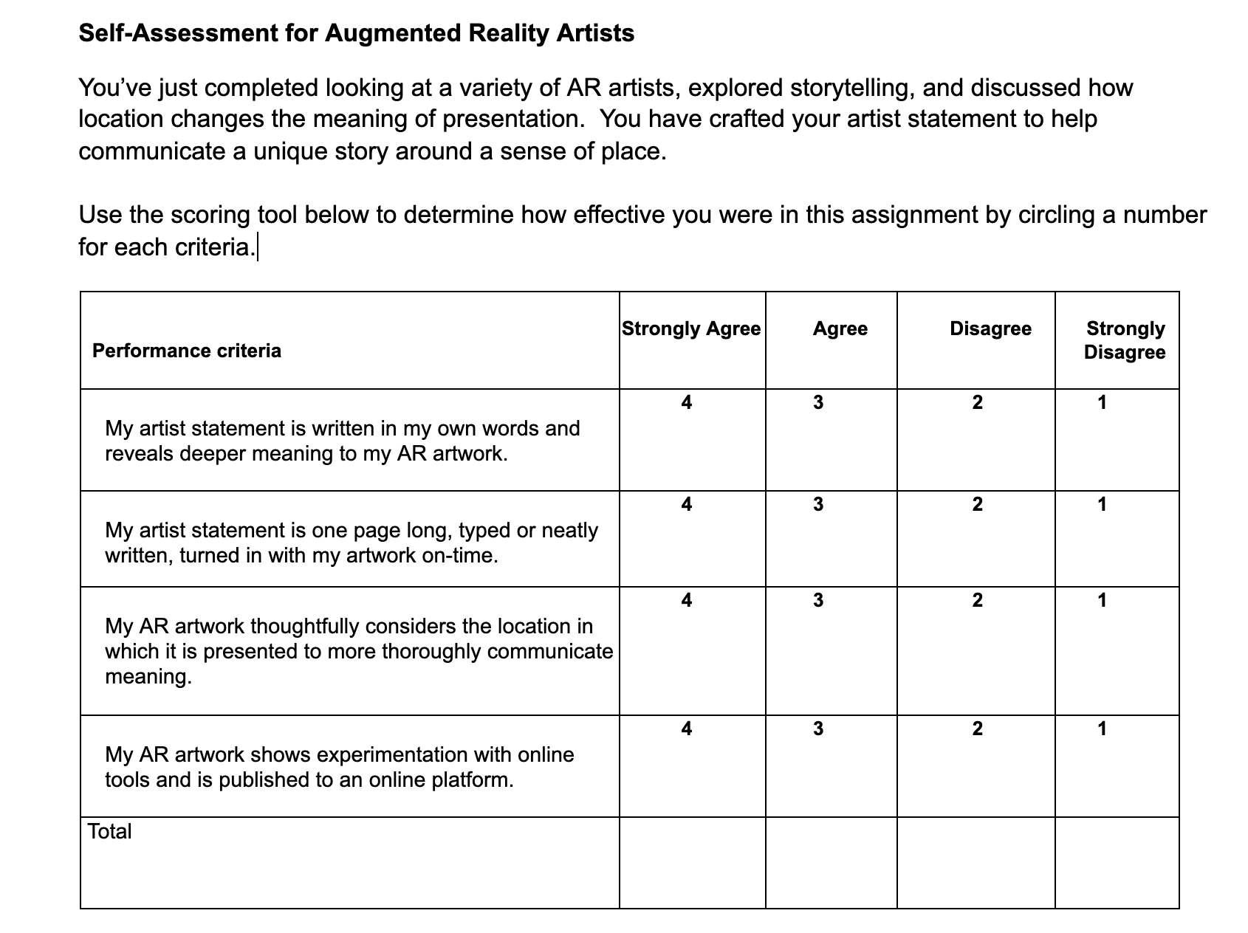
Rubric

Slide 18

Teacher Example

Slide 19
Artivive Tutorial!
HINT: Use the guided notes I provide during the tutorial - it will help you for your online, open-note quiz that’s due by Lesson 4! :)
Notes:
Acting as an expert on new media art, explain/sell a work that we've either discussed in class (or one that you choose from your own research) to someone who isn't aware of the work, doesn't know the artist, or just doesn't "get" new media. Another approach you can take is presenting a case to an art museum/institution as to why they should preserve this particular example of new media art.
In at least 10 slides, convince this person/museum on why the work is art, why it is valuable, and why it i

Slide 20
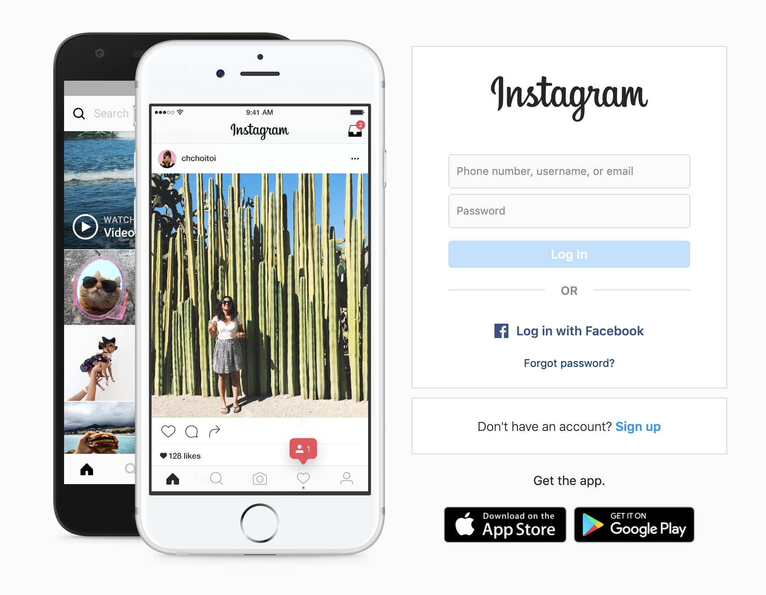
Step 1.
Go to
Instagram.com
to get an
account

Slide 21
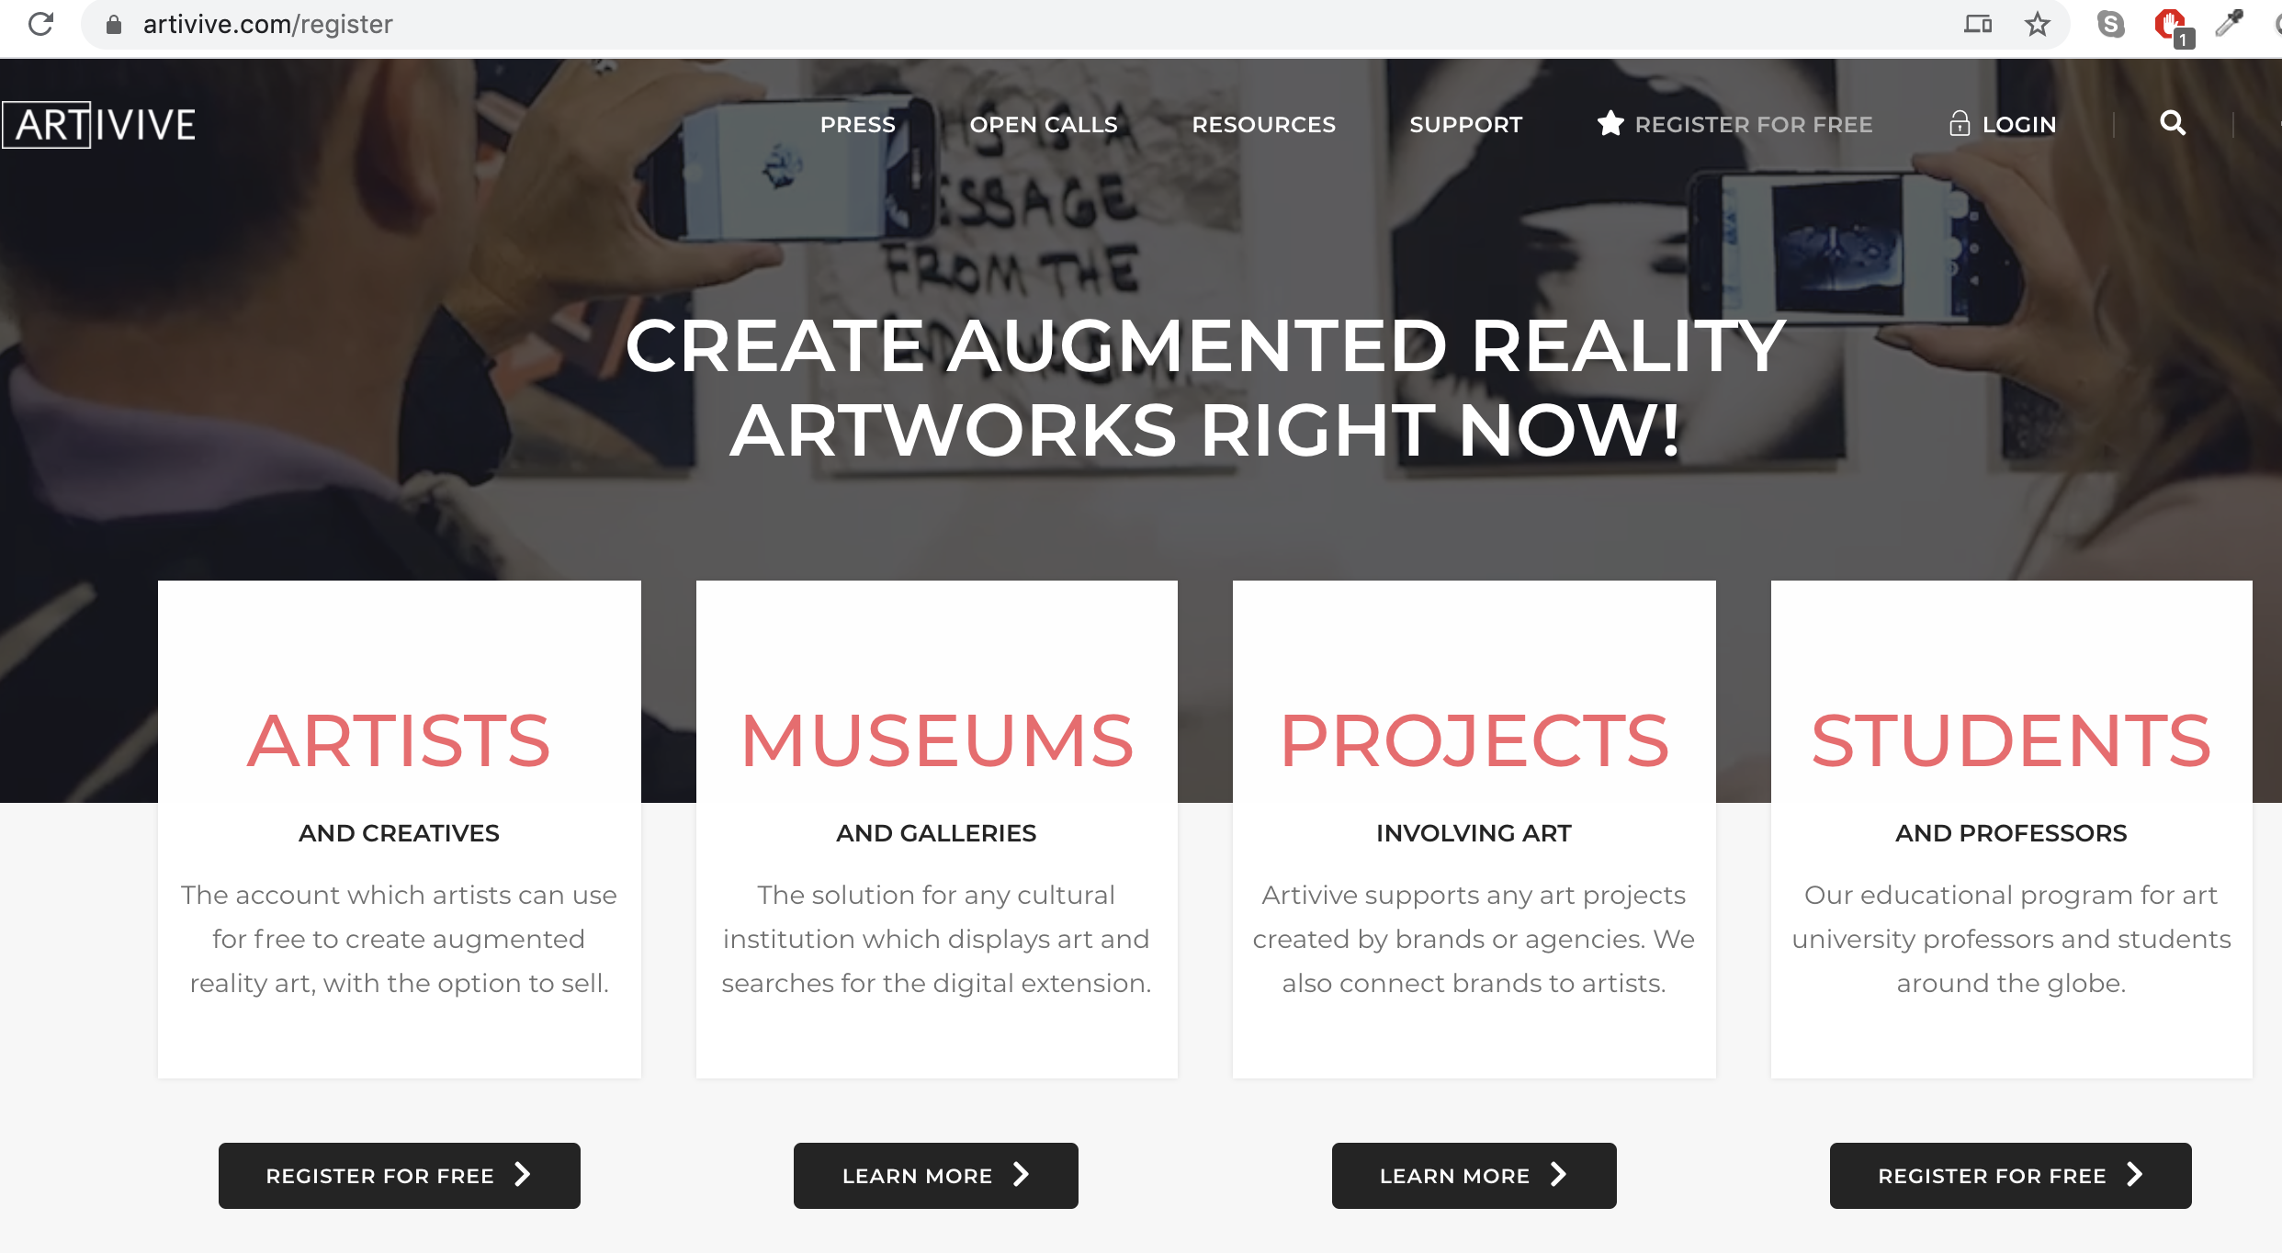
Step 2. Artivive Account

Slide 22
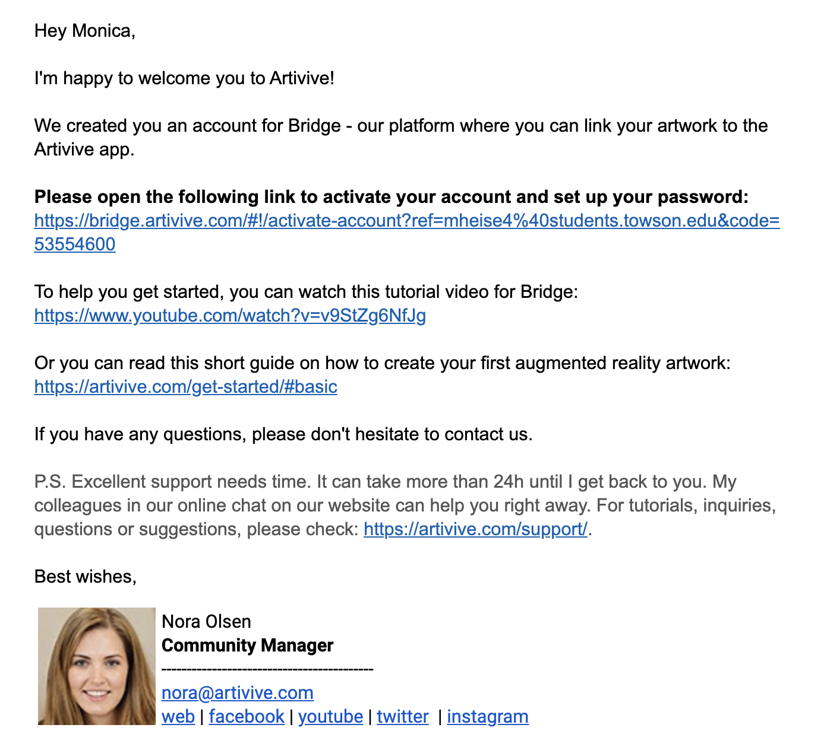
Step 3.
Activate
Account

Slide 23
Artivive Resources
Step-by-Step Instructions: https://artivive.com/get-started/#basic
Video Tutorial: https://www.youtube.com/watch?v=v9StZg6NfJg
Royalty Free Videos: https://www.pexels.com/
How to make an image with a transparent background: https://www.youtube.com/watch?v=vnu6FDMCL1Y

Slide 24
Sources
(2018, November 01). Augmented Reality (AR) as an Artist's Tool for Equity and Access | Nancy Baker Cahill | TEDxPasadena. Retrieved August 4, 2019, from https://www.youtube.com/watch?v=qomqvLGgcgs
Cahill, N. B. (2018). Public Art Projects. Retrieved August 3, 2019, from https://www.4thwallapp.org/special-projects
Furman, A. (2018, November 2). How virtual art appearing along the L.A. River tackles gentrification, immigration and environmental issues. LA Times. Retrieved August 4, 2019, from https://www.latimes.com/entertainment/arts/museums/la-et-cm-4th-wall-vr-art-nancy-baker-cahill-20181029-story.html
Martin, B. (2018, August 14). Artists Are Using Augmented Reality to Install Virtual Works in Powerful Places. Los Angeles Magazine. Retrieved August 6, 2019, from https://www.lamag.com/culturefiles/4th-wall-ar-art/

