Slide 1
Black Lives Matter
Week of Action in Art
3rd Grade at Charles Carroll Barrister
February 3 - 8, 2020

Slide 2
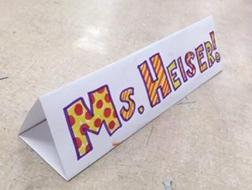
Name Tag Tents!
Fold your paper in thirds, “hot-dog style”
Write your Name

Slide 3
Today we will:
Talk about the week of action in schools;
read about restorative justice and bullying;
develop, create, and display our own peace agreements for our art room
play a restorative justice game!
… in order to create an art class that believes that Black Lives Matter !

Slide 4
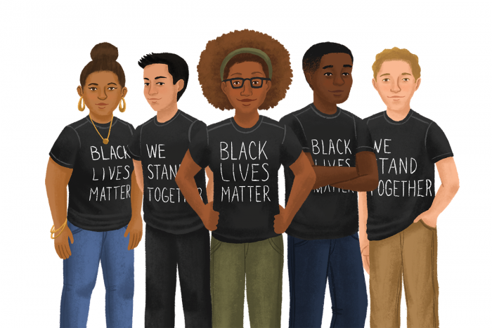
What’s this Week about?
It all started at one elementary school 3 years ago. Educators and community partners were set to celebrate their Black students and wear BLM shirts to school. Then some hateful person made a bomb threat to the school.
In solidarity, educators around Seattle organized around 3,000 educators to wear “Black Lives Matter,” shirts to school--many with many with“#SayHerName”--and teach lessons about institutional racism.
Now in 2020 school year, from February 1 - 9, thousands of schools across the United States will teach lessons about opposing racism, complex black identities, black history, and anti-racist movements for a nationally organized week of action.

Slide 5
Topics this Week in Art Class:
Mon. Feb 3: Restorative Justice
Tues. Feb 4: Black History and Activism
Wed. Feb 5: No Art: Half-day of school
Thurs. Feb 6: Diverse Families
Fri. Feb 7: Black Women Artists

Slide 6
What is Restorative Justice?
RESTORE = repair, heal, make better
JUSTICE = fairness, equality, the right thing
Not only saying sorry, but also trying to make it better.

Slide 7

Discussion
Initially the colors were bystanders… why did the colors decide to become upstanders?
What would you have done if you have been one of the other colors?
What would you have said to Red?
Would you have invited Red to become your friend after everything had happened?
https://www.youtube.com/watch?v=SbgsR0SP0y0

Slide 8
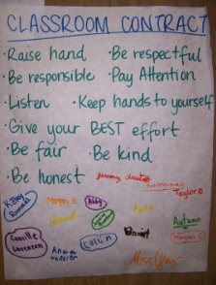
Peace
Agreements
< -- Example

Slide 9
Rules to the Peace-Maker Game!
Everyone gets two pieces of candy.
The candy must be still and quiet … no fussing or fiddling with the candy!
This circle is a sacred place for our community, and student-created distractions are considered signs of disrespect for this process.
When it is your turn, you can either give a specific compliment to someone in the circle, or pass to keep your candy.
In this game our focus is on current actions, those that have happened in the past week.
When giving a compliment do so using specific language that describes actions.
When giving a compliment, do your best to look the other person in the eyes. If this is too difficult, practice getting closer to this goal by looking at the other person’s forehead.
You may choose to pass when it’s your turn and keep your candy, though you may not re-claim your turn later.

Slide 10
Today we will:
Watch a short video about a kid activist
Read books and discuss Black History and activism in small groups at our table.
Write a letter and/or draw a picture to mail to our future Congressman.
… in order to create a world that believes that Black Lives Matter !

Slide 11


Slide 12

Mari Copeny
12-year-old activist, philanthropist, and “future president” Mari Copeny is on the front lines helping kids to embrace their power through equal opportunity.
Flint Water Crisis - instead of feeling helpless Mari decided to use her voice to help out her community and to fight for the kids in Flint and she has not stopped since.
She has expanded her effort to help communities across the nation dealing with toxic water.
Video Link (stop at 2 min 30 sec): https://www.youtube.com/watch?v=ML2dRP9i3FQ

Slide 13

Book Time!
Who stood out to you and why?
What issues or challenges were these young activists trying to fight, overcome or change?
How did they use to create change?
What are some of our own challenges in Baltimore?
How would we as artists create meaningful artwork to to fight, overcome or change our own challenges?

Slide 14
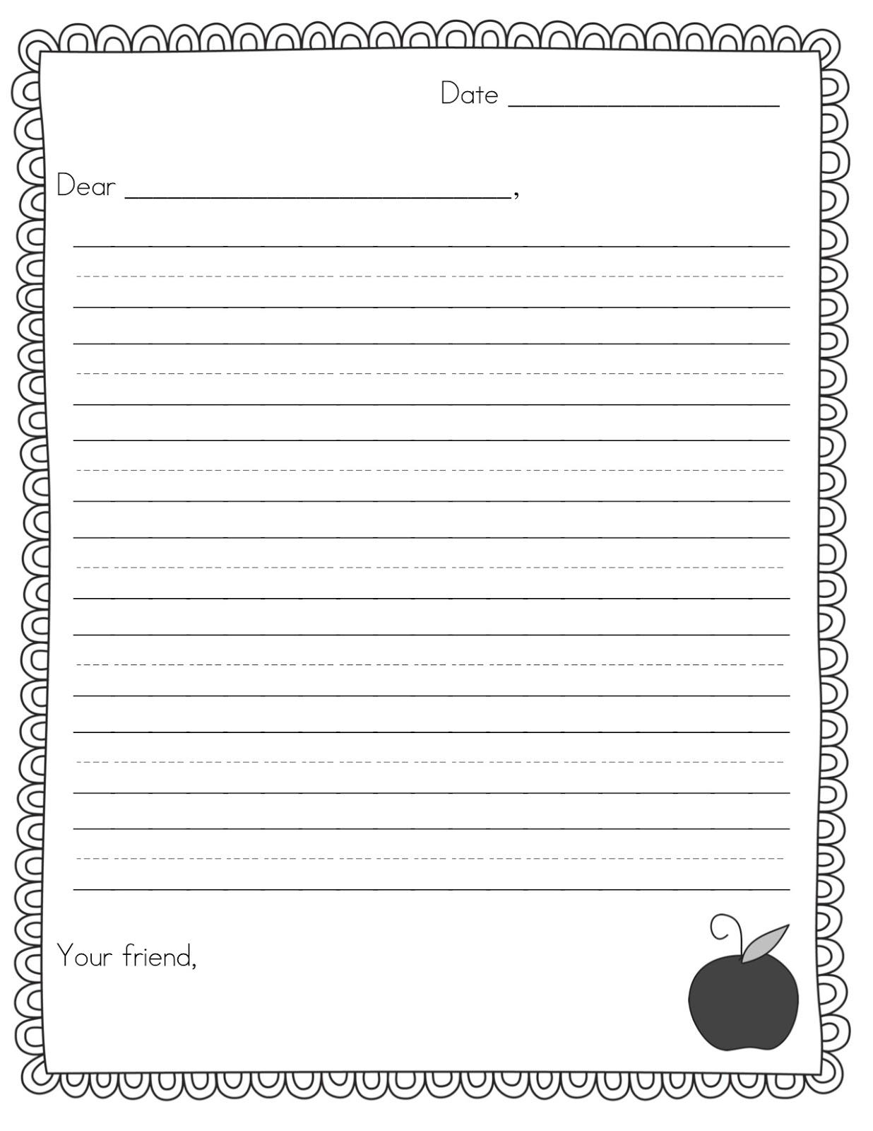
One type of Activism: Letter writing
Our Congressperson, Elijah Cummings, passed away last October. Today, Tues, Feb. 4th is the day to vote in the primary!
What qualities would you want in our new Congressperson?
Let’s be activists! Either write a letter and/or draw a picture to Mari Copeny or your future congressperson about an issue that bothers you!
https://www.youtube.com/watch?v=4KIhWZl4k9U

Slide 15
Today we will:
Play a game to see what we think is a family
Read The Family Book by Todd Parr
Go on a Family Scavenger Hunt
Draw a picture of your family
… in order to create a community that believes that Black Lives Matter !

Slide 16
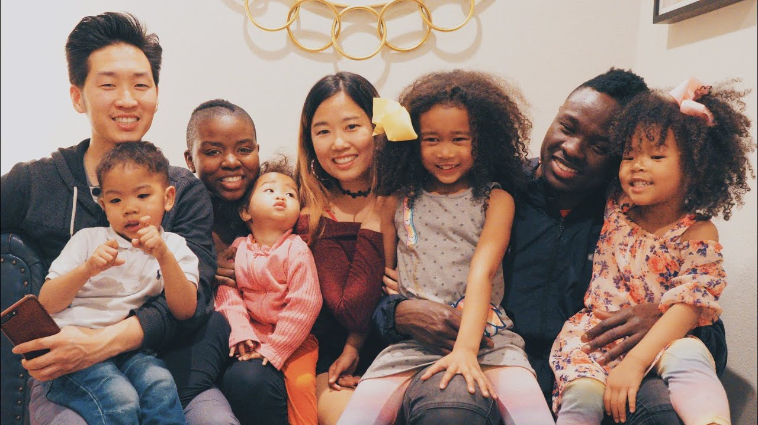
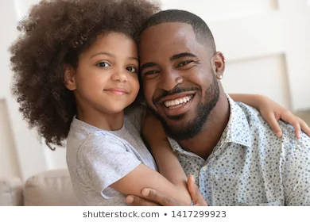
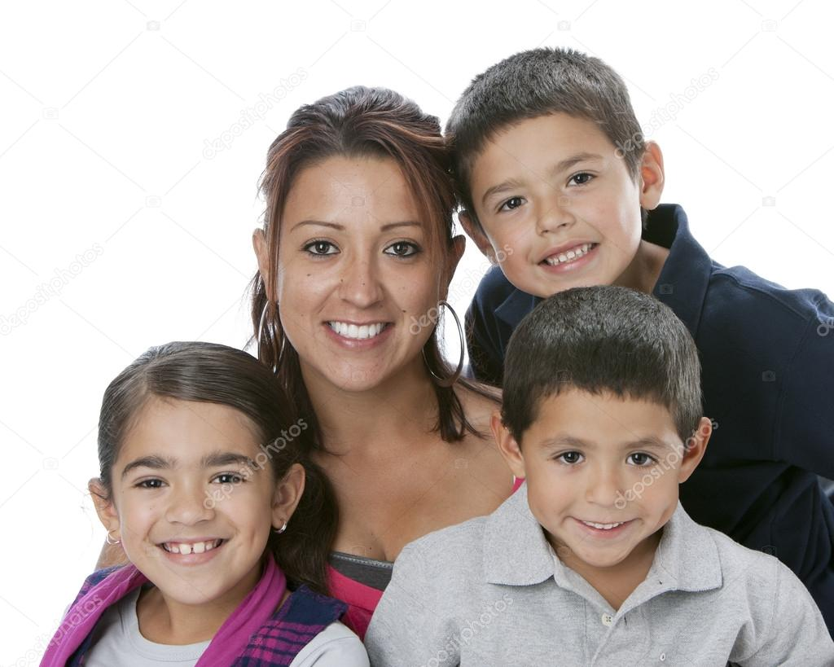
Game time!
Stand up every time you hear a description of a family.

Slide 17

The Family Book
What makes a family? What is unique about my family?
What makes a family a type of community?
How does having different kinds of families make our community richer?
Why is it important to learn about different types of families?

Slide 18
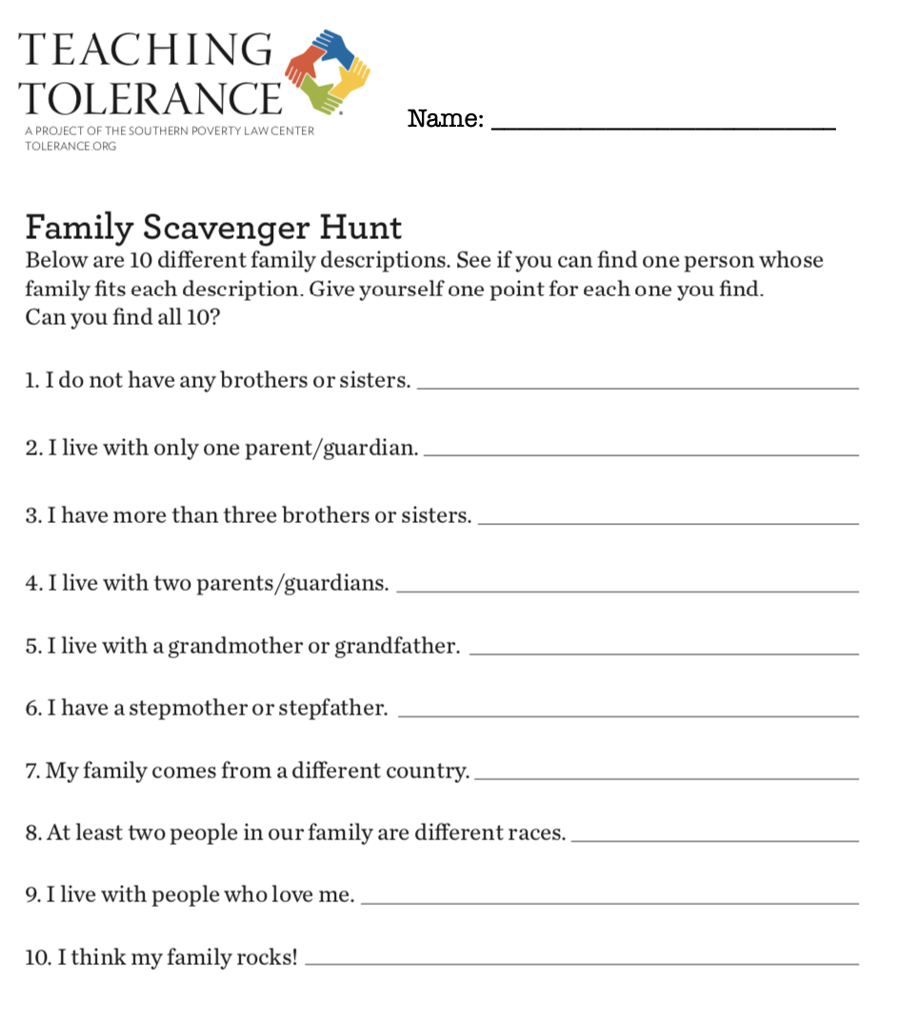
Family Scavenger Hunt!
Each of you gets your own worksheet.
You all will get up out of your seats and talk to one another to find 10 **DIFFERENT** people in this class who have these families.
The first person to give me their sheet completed, with all the answers correct, without repeating a student, will get a prize!

Slide 19
Draw Your Family!
You will get one quilt square.
Draw your family.
Try to include things that make your family unique, special, or diverse.
Maybe include activities of what you do as a family
Use a variety of colors.

Slide 20
Today we will:
Learn about Faith Ringgold, a black woman artist
Read her book, Tar Beach
Add to our family pictures with fabric borders
Make another quilt square about US!
… in order to create art that shows that Black Lives Matter !

Slide 21
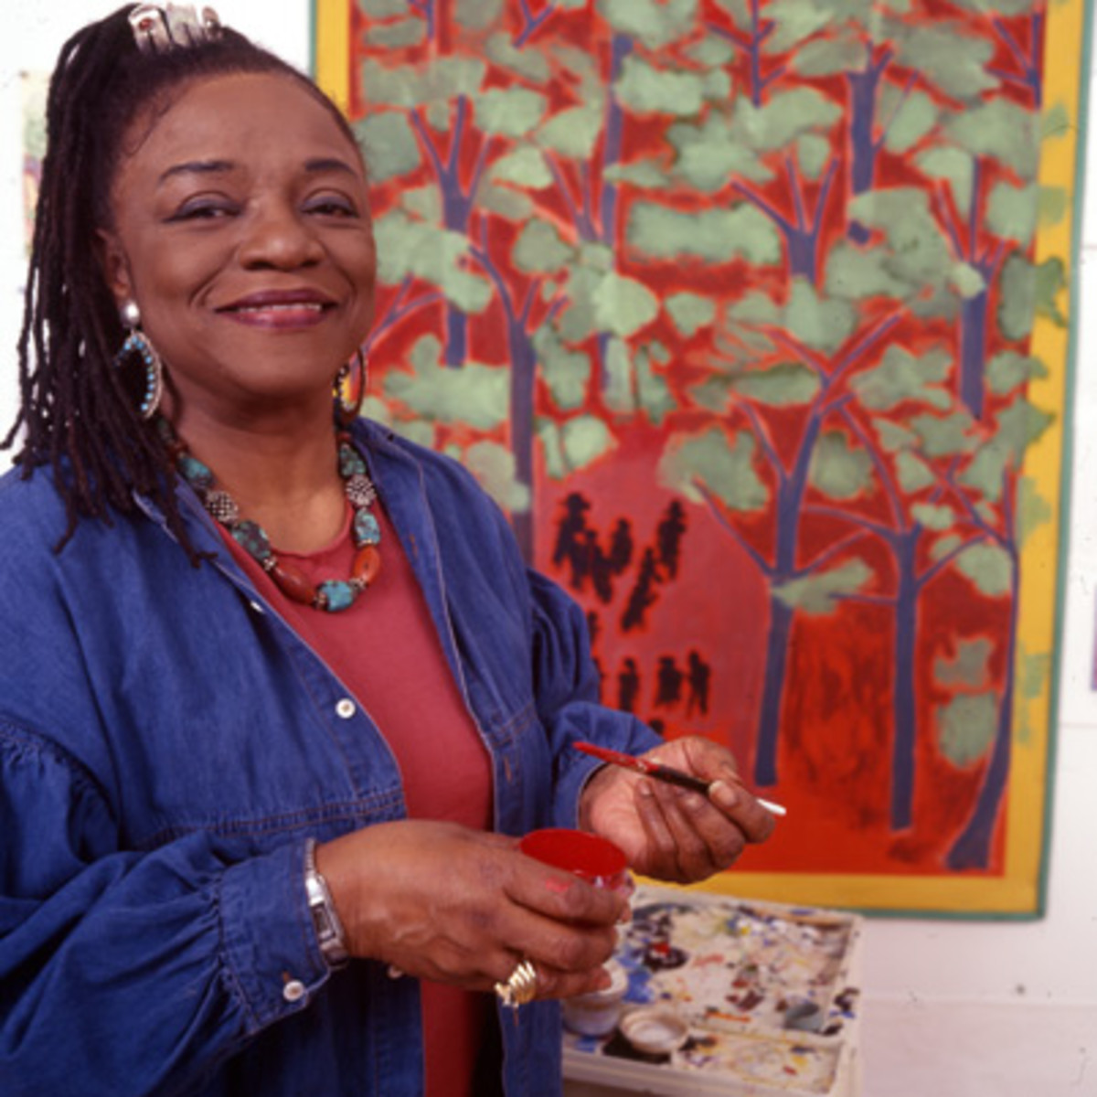

Faith Ringgold and her book, Tar Beach
https://www.youtube.com/watch?v=cU9MpcHfwiA (stop at 5:01”)
https://www.youtube.com/watch?v=h9RKJleFdBU

Slide 22
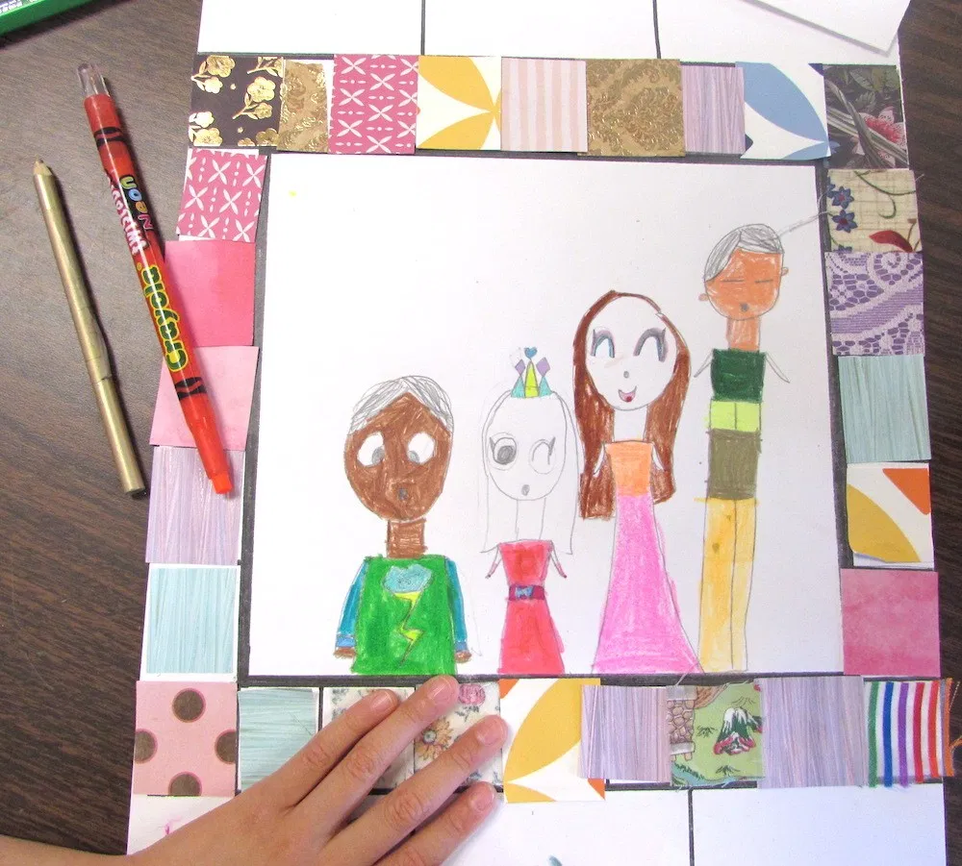
Next Step!
Finish your family portrait
  Add color!
  Add detail!
  Add what makes your family special!
Add fabric squares to the border of your quilt
When you’re done you can:
  Make another quilt square or
  Coloring sheet
Clean Up: https://www.youtube.com/watch?v=bXFjuymX4HI

Slide 23
Be The Teacher!
Write three key ideas they think everyone should have learned from this unit:
1.
2.
3.

